Slide 1
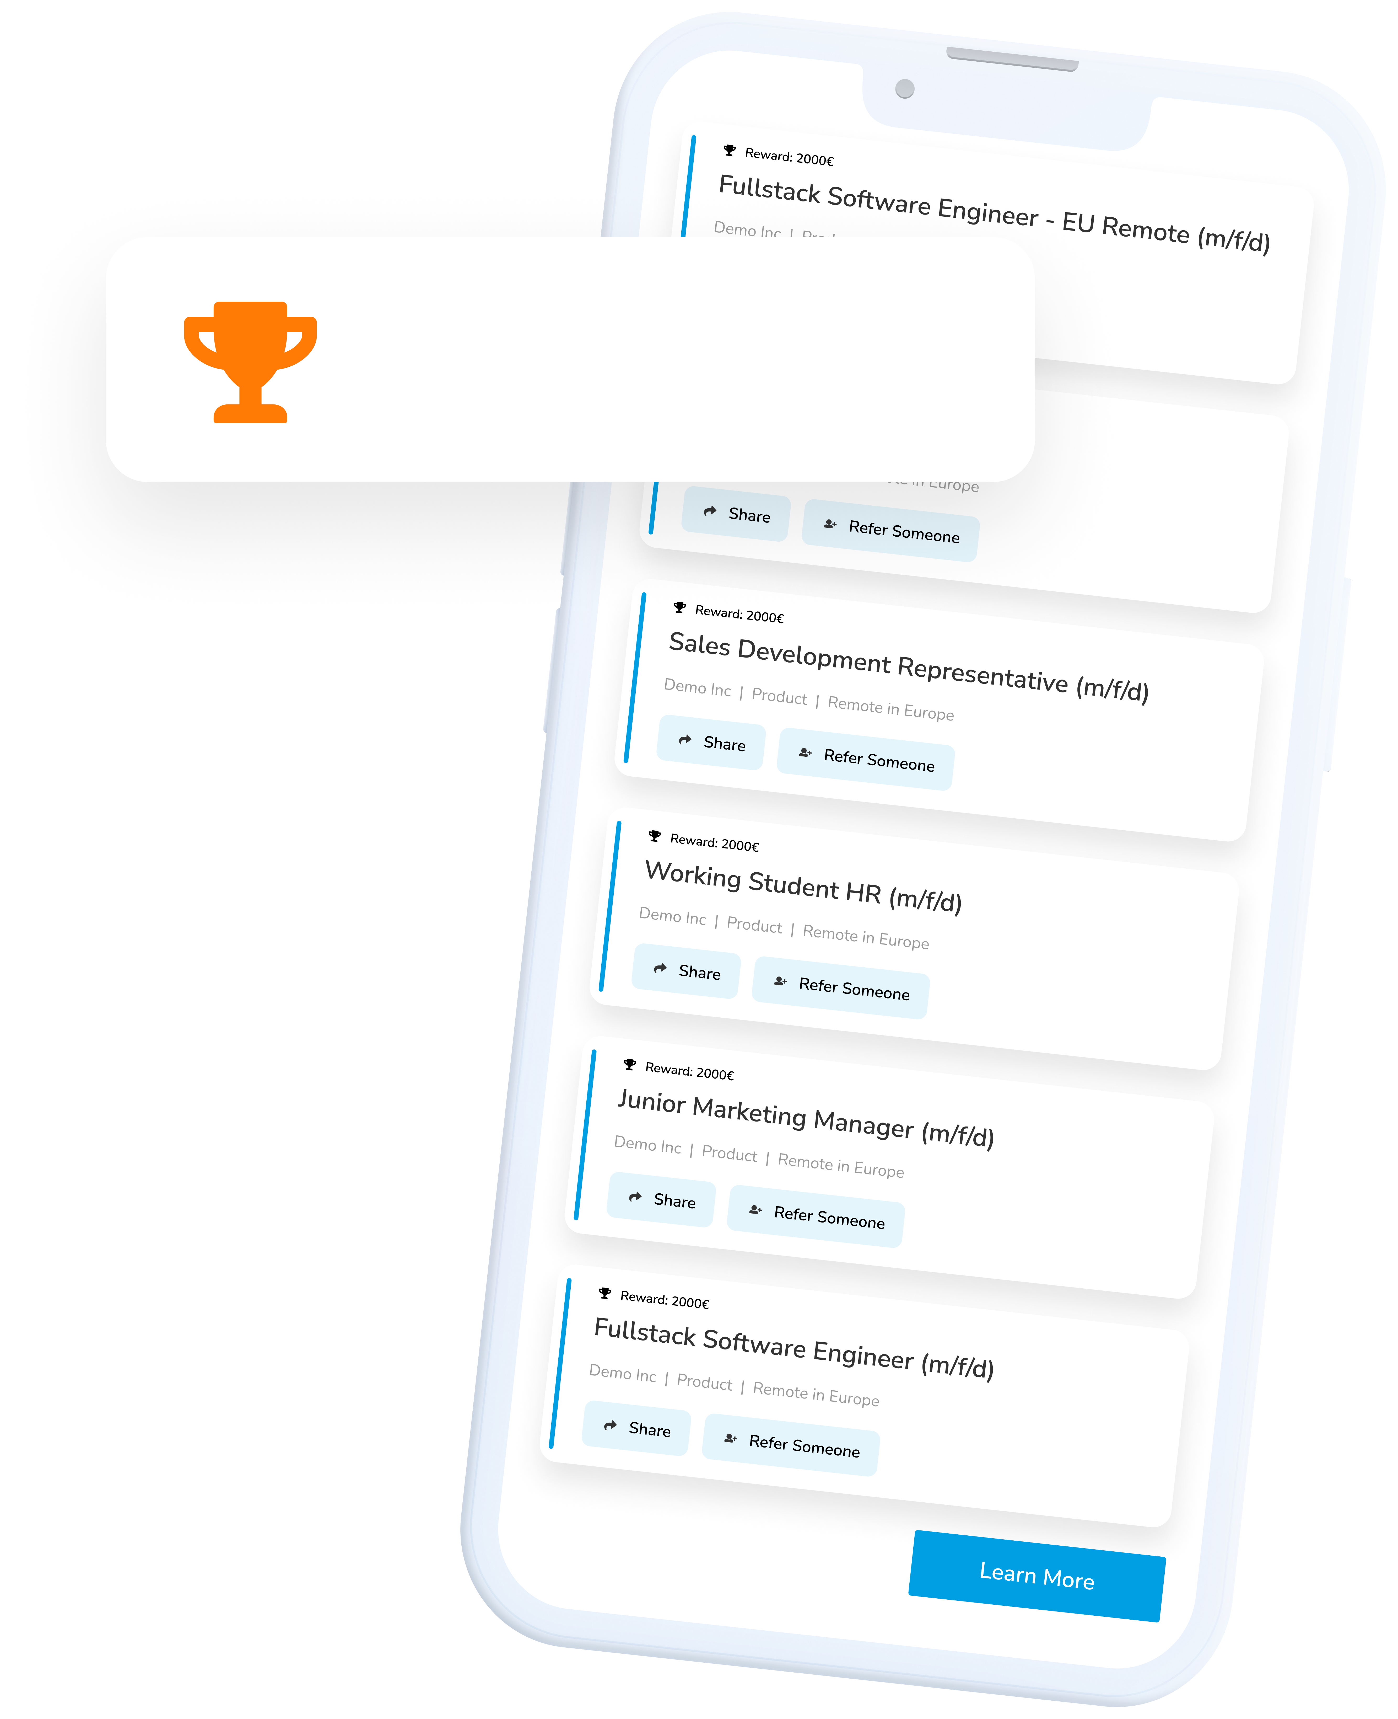
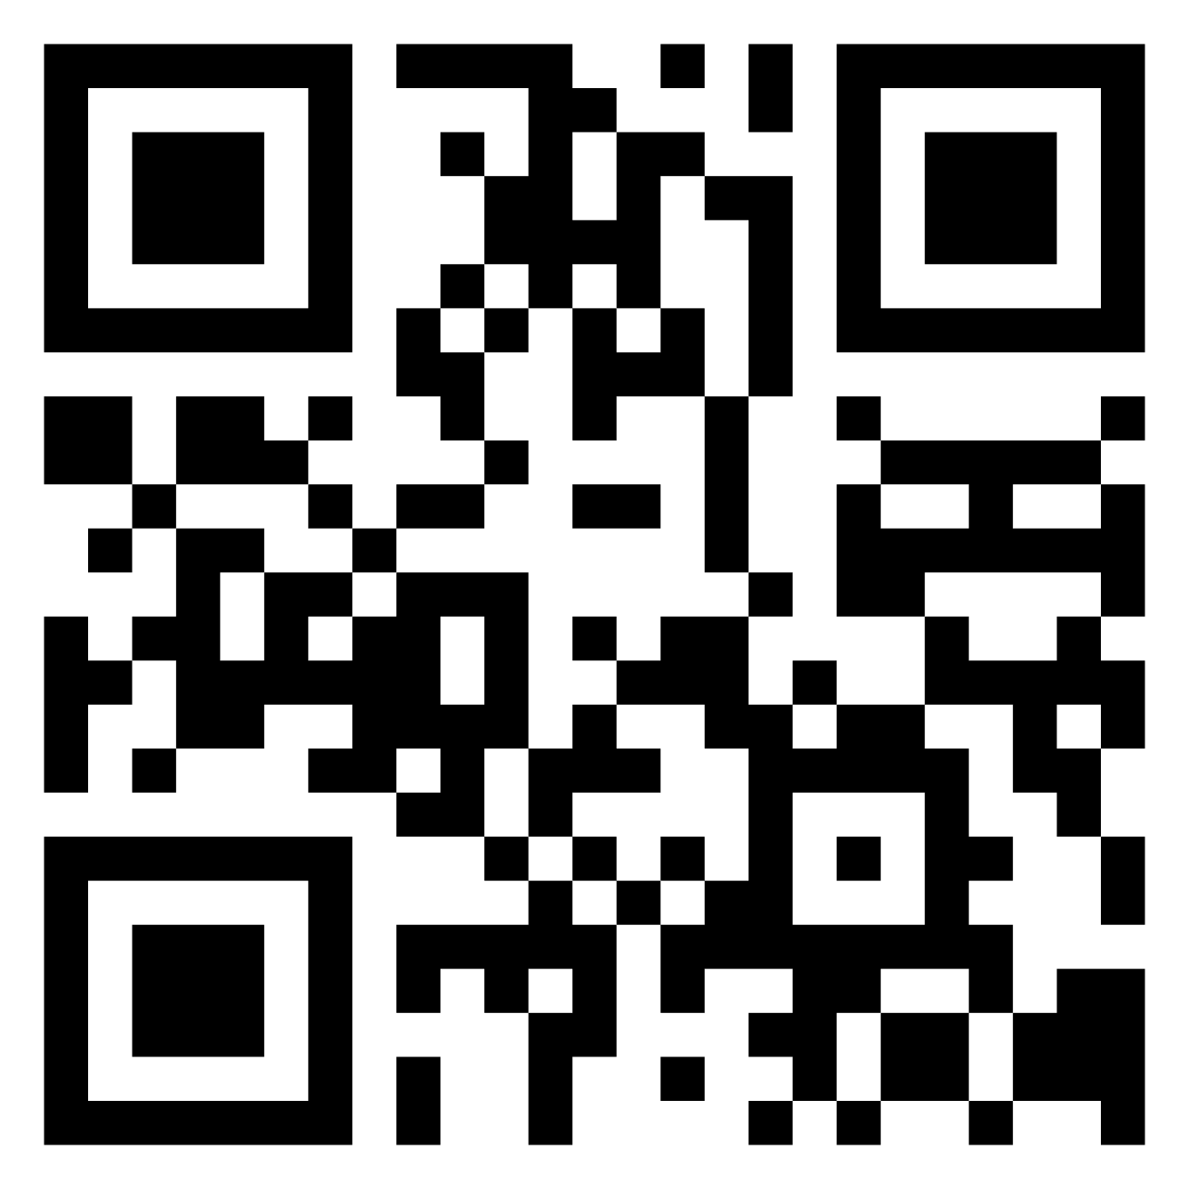
Employees Recruit Employees
WIN-WIN-WIN
You help your friends & acquaintances to find an exciting new job – thanks to you, we gain employees that are a perfect match for us! We’ll reward you for your efforts.
HOW IT WORKS!
Reward: €1000
1. Register with Talentry 2. Browse vacancies 3. Recommend jobs with just a few clicks 4. Welcome new colleagues & look forward to a reward
You are our best and most authentic ambassadors!
Help us to fill vacancies with top candidates from your network. Get started now! Register at yourcompany.talentry.com - or get the app:

Slide 2
LOGO
Employees Recruit Employees
WIN-WIN-WIN
You help your friends & acquaintances to find an exciting new job – thanks to you, we gain employees that are a perfect match for us! We’ll reward you for your efforts.
HOW IT WORKS!
Reward: €1000
1. Register with Talentry 2. Browse vacancies 3. Recommend jobs with just a few clicks 4. Welcome new colleagues & look forward to a reward
You are our best and most authentic ambassadors!
Help us to fill vacancies with top candidates from your network. Get started now! Register at yourcompany.talentry.com - or get the app:

Slide 3
LOGO
Employees Recruit Employees
WIN-WIN-WIN
You help your friends & acquaintances to find an exciting new job – thanks to you, we gain employees that are a perfect match for us! We’ll reward you for your efforts.
HOW IT WORKS!
Reward: €1000
1. Register with Talentry 2. Browse vacancies 3. Recommend jobs with just a few clicks 4. Welcome new colleagues & look forward to a reward
You are our best and most authentic ambassadors!
Help us to fill vacancies with top candidates from your network. Get started now! Register at yourcompany.talentry.com - or get the app:

Slide 4
LOGO
Employees Recruit Employees
WIN-WIN-WIN
You help your friends & acquaintances to find an exciting new job – thanks to you, we gain employees that are a perfect match for us! We’ll reward you for your efforts.
HOW IT WORKS!
Reward: €1000
1. Register with Talentry 2. Browse vacancies 3. Recommend jobs with just a few clicks 4. Welcome new colleagues & look forward to a reward
You are our best and most authentic ambassadors!
Help us to fill vacancies with top candidates from your network. Get started now! Register at yourcompany.talentry.com - or get the app:

Slide 5
LOGO
Employees Recruit Employees
WIN-WIN-WIN
You help your friends & acquaintances to find an exciting new job – thanks to you, we gain employees that are a perfect match for us! We’ll reward you for your efforts.
HOW IT WORKS!
Reward: €1000
1. Register with Talentry 2. Browse vacancies 3. Recommend jobs with just a few clicks 4. Welcome new colleagues & look forward to a reward
You are our best and most authentic ambassadors!
Help us to fill vacancies with top candidates from your network. Get started now! Register at yourcompany.talentry.com - or get the app:

