Slide 1
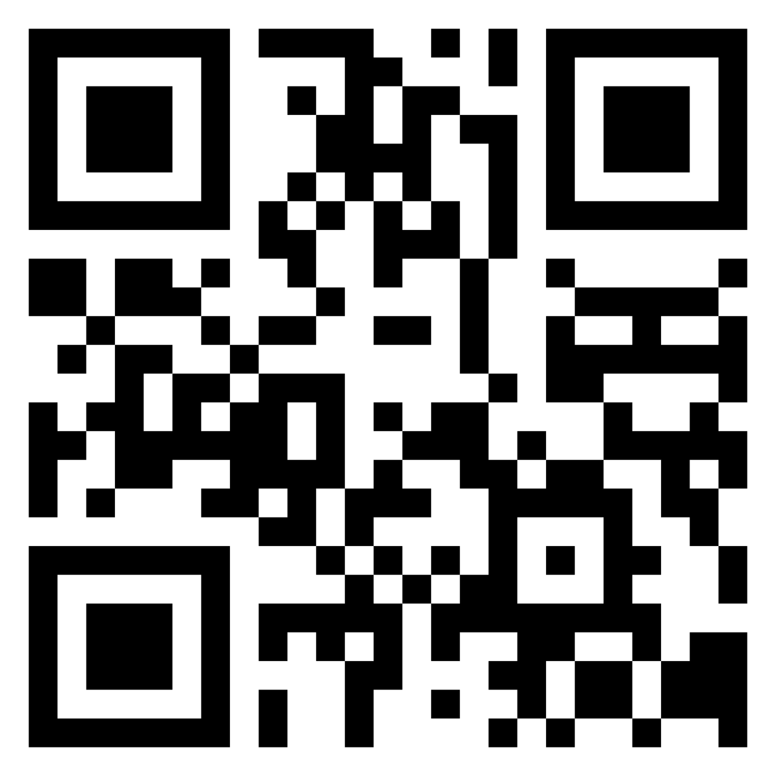
+ 5 Points
Employees Recruit Employees
WIN-WIN-WIN
You help your friends & acquaintances to find an exciting new job - thanks to you, we gain employees that are a perfect match for us! You collect points for every activity, which you can redeem for attractive rewards.
Reward: €1000

Slide 2
HOW IT WORKS!
1. Register with Talentry Talentry can be used with both the app and a browser on your computer. 2. Browse through job vacancies You’ll find a convenient overview in the app or in your account. You’ll receive regular updates, for example, in newsletters or push notifications. 3. Recommend jobs with just a few clicks Whether WhatsApp, LinkedIn, Xing, Twitter or Facebook – simply share vacancies with personal contacts or on social media using the link! 4. Collect points & redeem them for rewards Every share and every click on your link will earn you points. See your score in “My Successes”. Do you have enough points for your desired reward? Just exchange them! 5. Welcome new colleagues & look forward to a cash reward When one of your contacts is recruited, you receive an additional cash reward for your efforts.
You are our best and most authentic ambassadors!
Help us to fill vacancies with top candidates from your network. Get started now! Register at yourcompany.talentry.com - or get the app:

Slide 3
LOGO
+ 5 Points
Employees Recruit Employees
WIN-WIN-WIN
You help your friends & acquaintances to find an exciting new job - thanks to you, we gain employees that are a perfect match for us! You collect points for every activity, which you can redeem for attractive rewards.
Reward: €1000

Slide 4
HOW IT WORKS!
LOGO
1. Register with Talentry Talentry can be used with both the app and a browser on your computer. 2. Browse through job vacancies You’ll find a convenient overview in the app or in your account. You’ll receive regular updates, for example, in newsletters or push notifications. 3. Recommend jobs with just a few clicks Whether WhatsApp, LinkedIn, Xing, Twitter or Facebook – simply share vacancies with personal contacts or on social media using the link! 4. Collect points & redeem them for rewards Every share and every click on your link will earn you points. See your score in “My Successes”. Do you have enough points for your desired reward? Just exchange them! 5. Welcome new colleagues & look forward to a cash reward When one of your contacts is recruited, you receive an additional cash reward for your efforts.
You are our best and most authentic ambassadors!
Help us to fill vacancies with top candidates from your network. Get started now! Register at yourcompany.talentry.com - or get the app:

Slide 5
LOGO
+ 5 Points
Employees Recruit Employees
WIN-WIN-WIN
You help your friends & acquaintances to find an exciting new job - thanks to you, we gain employees that are a perfect match for us! You collect points for every activity, which you can redeem for attractive rewards.
Reward: €1000

Slide 6
HOW IT WORKS!
LOGO
1. Register with Talentry Talentry can be used with both the app and a browser on your computer. 2. Browse through job vacancies You’ll find a convenient overview in the app or in your account. You’ll receive regular updates, for example, in newsletters or push notifications. 3. Recommend jobs with just a few clicks Whether WhatsApp, LinkedIn, Xing, Twitter or Facebook – simply share vacancies with personal contacts or on social media using the link! 4. Collect points & redeem them for rewards Every share and every click on your link will earn you points. See your score in “My Successes”. Do you have enough points for your desired reward? Just exchange them! 5. Welcome new colleagues & look forward to a cash reward When one of your contacts is recruited, you receive an additional cash reward for your efforts.
You are our best and most authentic ambassadors!
Help us to fill vacancies with top candidates from your network. Get started now! Register at yourcompany.talentry.com - or get the app:

Slide 7
LOGO
+ 5 Points
Employees Recruit Employees
WIN-WIN-WIN
You help your friends & acquaintances to find an exciting new job - thanks to you, we gain employees that are a perfect match for us! You collect points for every activity, which you can redeem for attractive rewards.
Reward: €1000

Slide 8
HOW IT WORKS!
LOGO
1. Register with Talentry Talentry can be used with both the app and a browser on your computer. 2. Browse through job vacancies You’ll find a convenient overview in the app or in your account. You’ll receive regular updates, for example, in newsletters or push notifications. 3. Recommend jobs with just a few clicks Whether WhatsApp, LinkedIn, Xing, Twitter or Facebook – simply share vacancies with personal contacts or on social media using the link! 4. Collect points & redeem them for rewards Every share and every click on your link will earn you points. See your score in “My Successes”. Do you have enough points for your desired reward? Just exchange them! 5. Welcome new colleagues & look forward to a cash reward When one of your contacts is recruited, you receive an additional cash reward for your efforts.
You are our best and most authentic ambassadors!
Help us to fill vacancies with top candidates from your network. Get started now! Register at yourcompany.talentry.com - or get the app:

Slide 9
LOGO
+ 5 Points
Employees Recruit Employees
WIN-WIN-WIN
You help your friends & acquaintances to find an exciting new job - thanks to you, we gain employees that are a perfect match for us! You collect points for every activity, which you can redeem for attractive rewards.
Reward: €1000

Slide 10
HOW IT WORKS!
LOGO
1. Register with Talentry Talentry can be used with both the app and a browser on your computer. 2. Browse through job vacancies You’ll find a convenient overview in the app or in your account. You’ll receive regular updates, for example, in newsletters or push notifications. 3. Recommend jobs with just a few clicks Whether WhatsApp, LinkedIn, Xing, Twitter or Facebook – simply share vacancies with personal contacts or on social media using the link! 4. Collect points & redeem them for rewards Every share and every click on your link will earn you points. See your score in “My Successes”. Do you have enough points for your desired reward? Just exchange them! 5. Welcome new colleagues & look forward to a cash reward When one of your contacts is recruited, you receive an additional cash reward for your efforts.
You are our best and most authentic ambassadors!
Help us to fill vacancies with top candidates from your network. Get started now! Register at yourcompany.talentry.com - or get the app:

