Slide 1
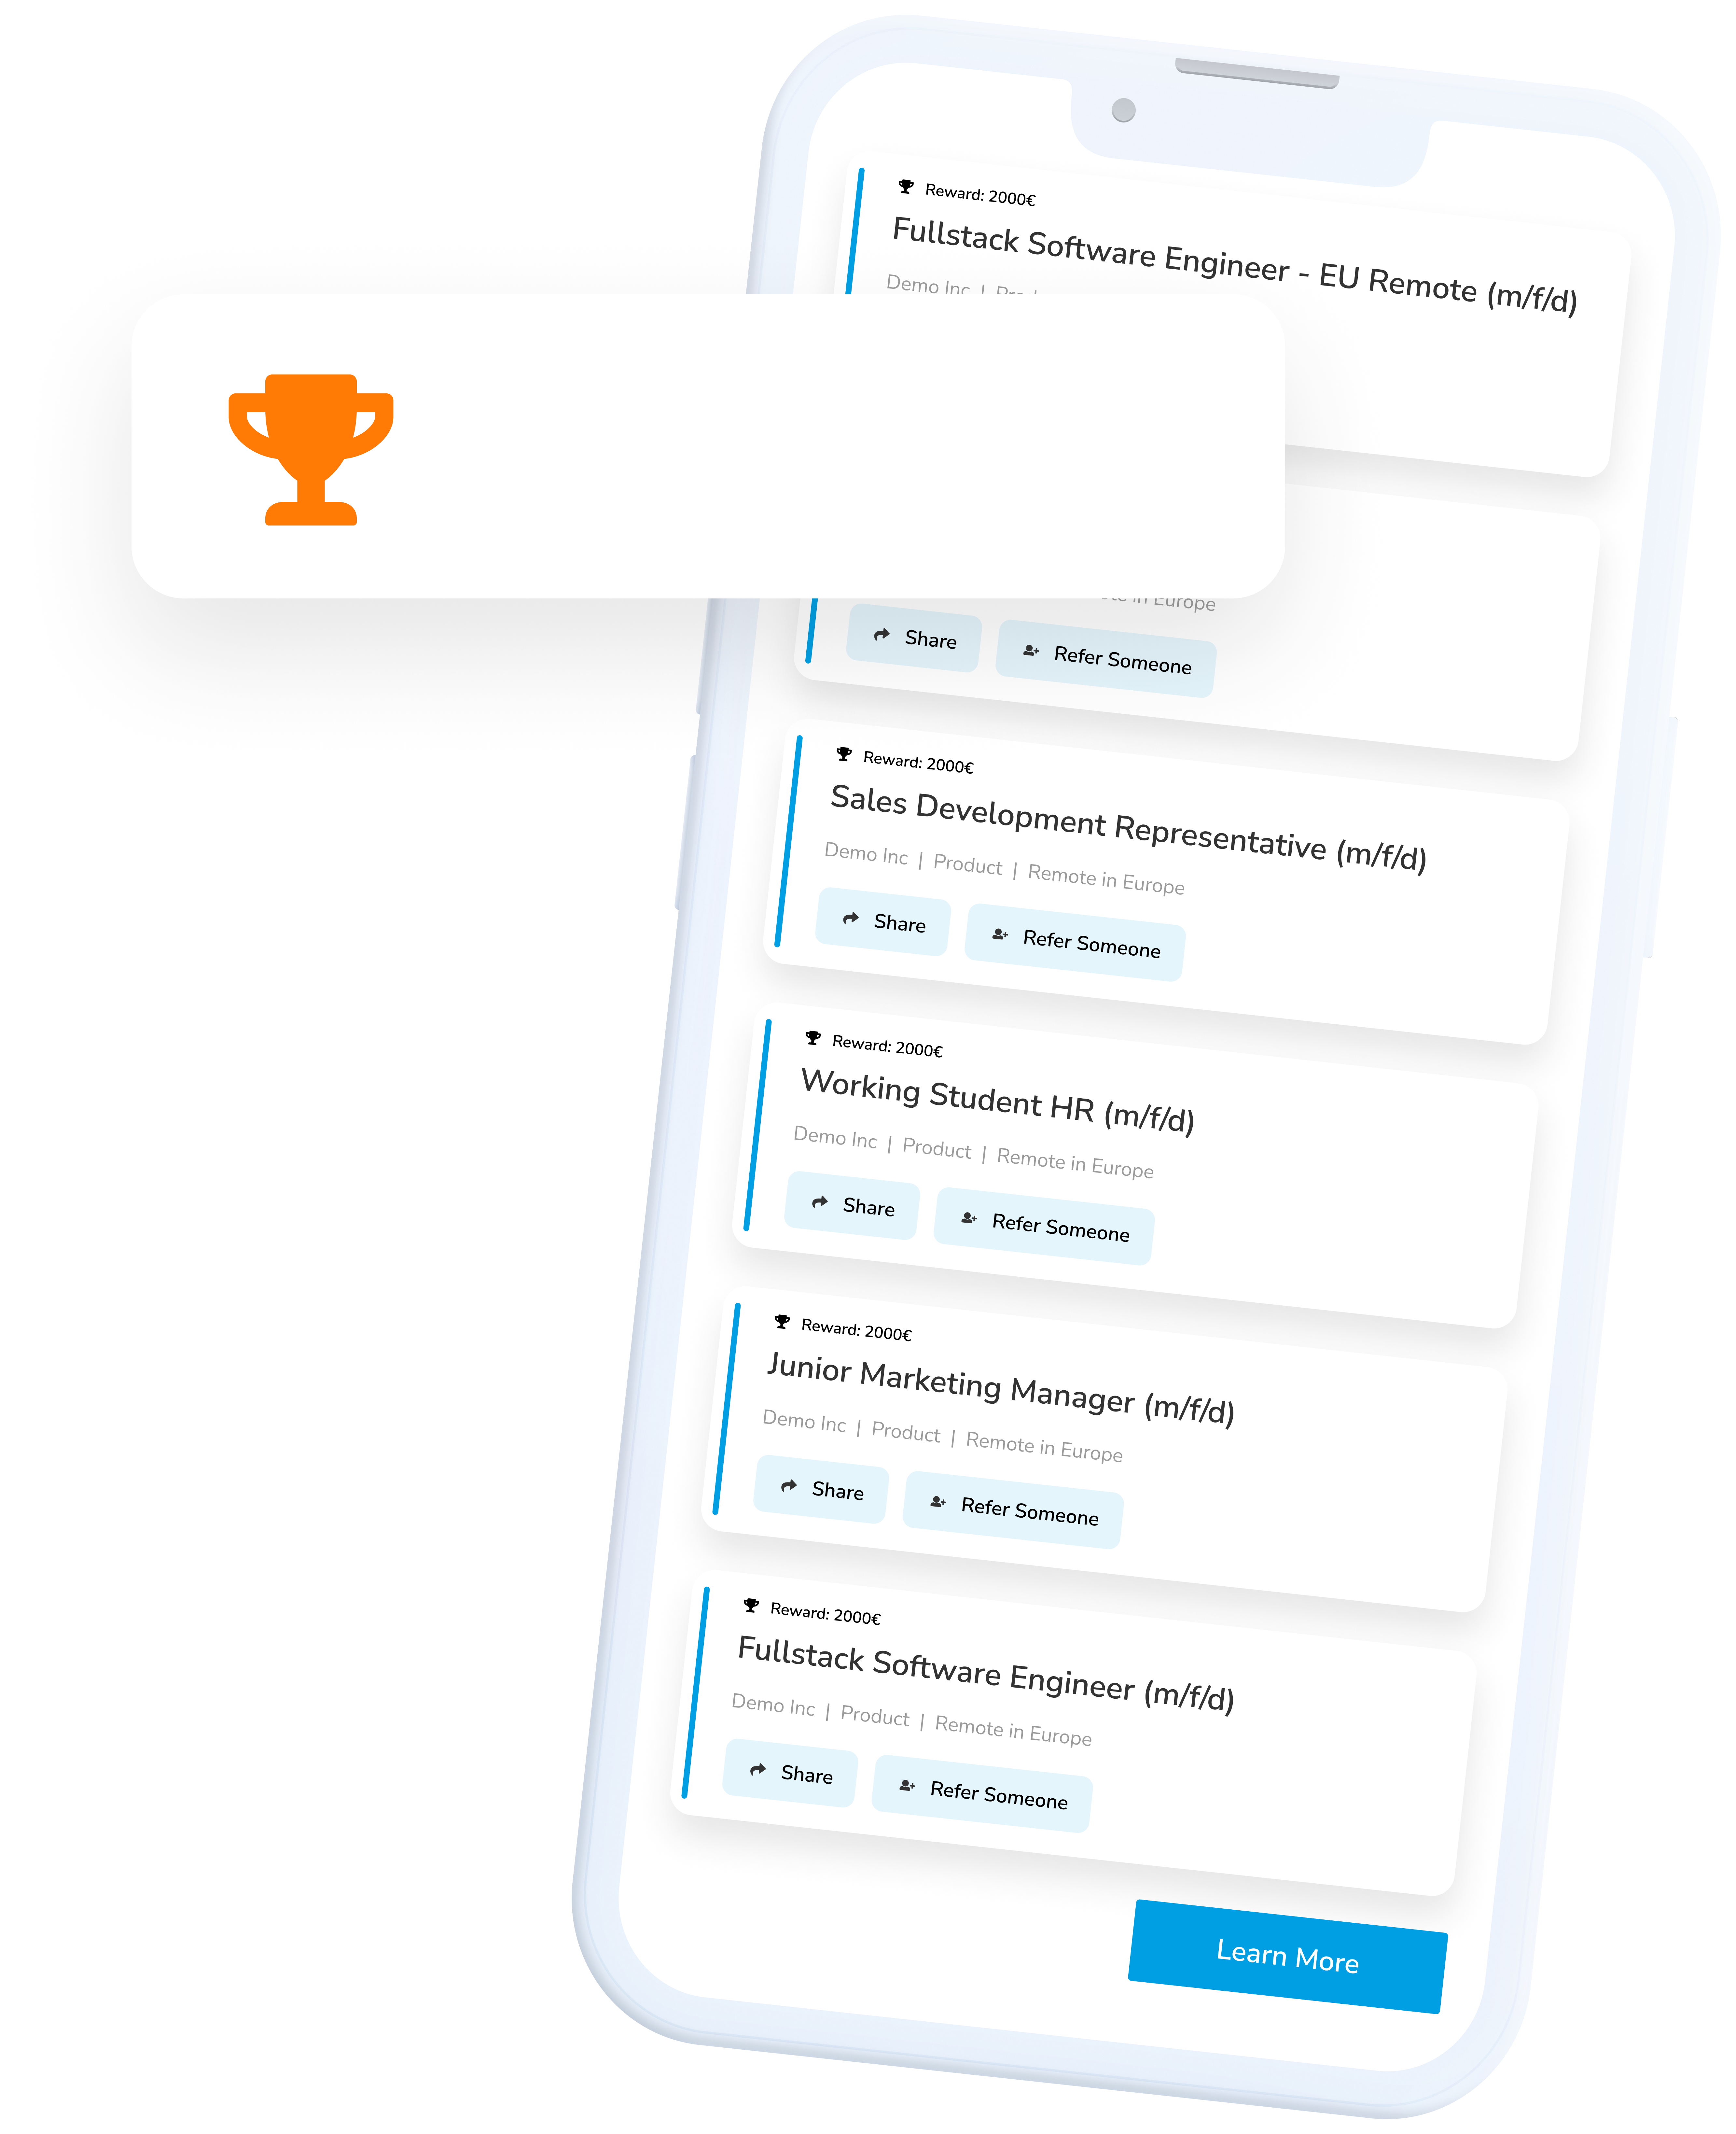
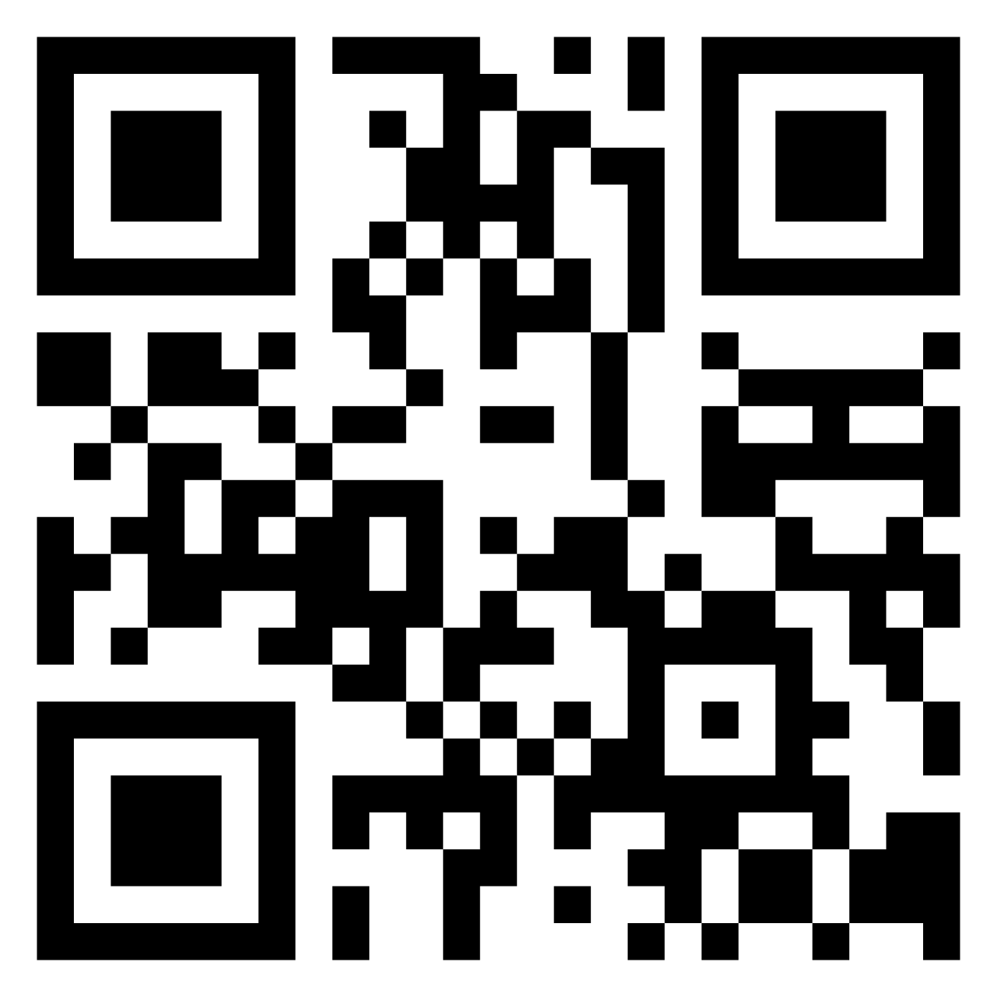
Employees Recruit Employees
Reward: €1000
WIN-WIN-WIN
You help your friends & acquaintances to find an exciting new job – thanks to you, we gain employees that are a perfect match for us! We’ll reward you for your efforts.

Slide 2
HOW IT WORKS!
1. Register with Talentry Talentry can be used with both the app and a browser on your computer. 2. Browse through job vacancies You’ll find a convenient overview in the app or in your account. You’ll receive regular updates, for example, in newsletters or push notifications. 3. Recommend jobs with just a few clicks Whether WhatsApp, LinkedIn, Xing, Twitter or Facebook – simply share vacancies with personal contacts or on social media platforms using the link! 4. Welcome new colleagues & look forward to a reward When one of your contacts is recruited, you receive a reward for your efforts.
You are our best and most authentic ambassadors!
Help us to fill vacancies with top candidates from your network. Get started now! Register at ourcompany.talentry.com - or get the app:

Slide 3
LOGO
Employees Recruit Employees
Reward: €1000
WIN-WIN-WIN
You help your friends & acquaintances to find an exciting new job – thanks to you, we gain employees that are a perfect match for us! We’ll reward you for your efforts.

Slide 4
HOW IT WORKS!
LOGO
1. Register with Talentry Talentry can be used with both the app and a browser on your computer. 2. Browse through job vacancies You’ll find a convenient overview in the app or in your account. You’ll receive regular updates, for example, in newsletters or push notifications. 3. Recommend jobs with just a few clicks Whether WhatsApp, LinkedIn, Xing, Twitter or Facebook – simply share vacancies with personal contacts or on social media platforms using the link! 4. Welcome new colleagues & look forward to a reward When one of your contacts is recruited, you receive a reward for your efforts.
You are our best and most authentic ambassadors!
Help us to fill vacancies with top candidates from your network. Get started now! Register at ourcompany.talentry.com - or get the app:

Slide 5
LOGO
Employees Recruit Employees
Reward: €1000
WIN-WIN-WIN
You help your friends & acquaintances to find an exciting new job – thanks to you, we gain employees that are a perfect match for us! We’ll reward you for your efforts.

Slide 6
HOW IT WORKS!
LOGO
1. Register with Talentry Talentry can be used with both the app and a browser on your computer. 2. Browse through job vacancies You’ll find a convenient overview in the app or in your account. You’ll receive regular updates, for example, in newsletters or push notifications. 3. Recommend jobs with just a few clicks Whether WhatsApp, LinkedIn, Xing, Twitter or Facebook – simply share vacancies with personal contacts or on social media platforms using the link! 4. Welcome new colleagues & look forward to a reward When one of your contacts is recruited, you receive a reward for your efforts.
You are our best and most authentic ambassadors!
Help us to fill vacancies with top candidates from your network. Get started now! Register at ourcompany.talentry.com - or get the app:

Slide 7
LOGO
Employees Recruit Employees
Reward: €1000
WIN-WIN-WIN
You help your friends & acquaintances to find an exciting new job – thanks to you, we gain employees that are a perfect match for us! We’ll reward you for your efforts.

Slide 8
HOW IT WORKS!
LOGO
1. Register with Talentry Talentry can be used with both the app and a browser on your computer. 2. Browse through job vacancies You’ll find a convenient overview in the app or in your account. You’ll receive regular updates, for example, in newsletters or push notifications. 3. Recommend jobs with just a few clicks Whether WhatsApp, LinkedIn, Xing, Twitter or Facebook – simply share vacancies with personal contacts or on social media platforms using the link! 4. Welcome new colleagues & look forward to a reward When one of your contacts is recruited, you receive a reward for your efforts.
You are our best and most authentic ambassadors!
Help us to fill vacancies with top candidates from your network. Get started now! Register at ourcompany.talentry.com - or get the app:

Slide 9
LOGO
Employees Recruit Employees
Reward: €1000
WIN-WIN-WIN
You help your friends & acquaintances to find an exciting new job – thanks to you, we gain employees that are a perfect match for us! We’ll reward you for your efforts.

Slide 10
HOW IT WORKS!
LOGO
1. Register with Talentry Talentry can be used with both the app and a browser on your computer. 2. Browse through job vacancies You’ll find a convenient overview in the app or in your account. You’ll receive regular updates, for example, in newsletters or push notifications. 3. Recommend jobs with just a few clicks Whether WhatsApp, LinkedIn, Xing, Twitter or Facebook – simply share vacancies with personal contacts or on social media platforms using the link! 4. Welcome new colleagues & look forward to a reward When one of your contacts is recruited, you receive a reward for your efforts.
You are our best and most authentic ambassadors!
Help us to fill vacancies with top candidates from your network. Get started now! Register at ourcompany.talentry.com - or get the app:

